Slide 1

Telco Operator Supports for Digital Marketing Growth
Tanto Surioto
August 2017

Slide 2




TANTO SURIOTO
Chief Enterprise & Business Solution Sales
PT. Smartfren Telecom Tbk
Founder dan Waketum
Asosiasi Pebisnis Online Indonesia
Founder dan Pembina
Komunitas #PejuangOnline
Founder and Pembina
Naked Sales Team
The Most Innovative Digital Business Contributor Indonesia 2016
Contact
Email :
Mobile :
WA :
tanto.surioto@smartfren.com
+62 888 185 0606
+62 818 6 555 67

Slide 3

It is Marketing!!
Marketing Methods are constantly changing.
Marketing Goals still remain the same: increase awareness, generate sales and build loyalty.
Traditional marketing: business cards, printed adverts, magazines, posters, brochures and TV commercials etc.
Digital marketing: social media, SEO, analyzing data, videos and interactive content and more.

Slide 4
Traditional Marketing
Easy to reach local target audiences, eq. Local Newspaper.
Physical Marketing Materials : enable audiences to read them several times, keep them for later reference, eq. Flyers.
Easy to understand for certain target audiences segment.

Slide 5
Digital Marketing
Targeted Audiences, campaigns to specific demographics: age groups, locations, interests, etc.
Increased interaction, two-way communication with target audiences through social media.
Cost Effective, social media is essentially free: ads is relatively cheap as you are only charged when someone clicks on your ads.
Easy Data Analysis: social media insight tools, eq. Google Analytics
Real time Result and Easy to be Measured.
Ads can be altered and adjusted

Slide 6
Is Conventional Marketing Still Relevant
When Both Digital and Traditional marketing strategies are planned and managed in concert, they can have a huge impact.
Use radio ads to publicize Website and Social Medias.
Use QR codes in print ads to give customers instant coupons and deals through their phone.

Slide 7
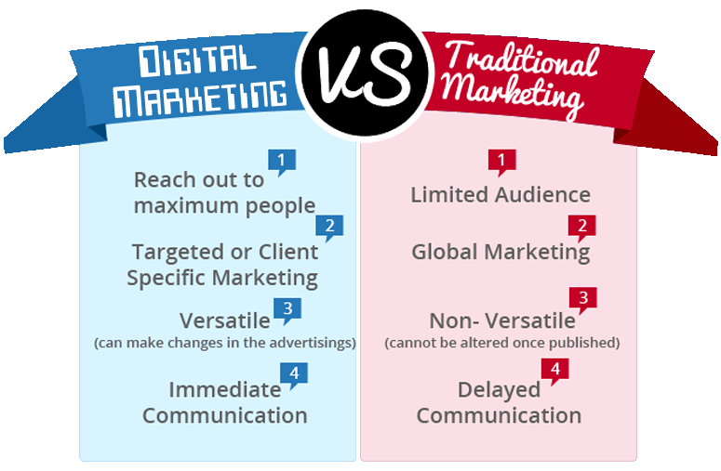

Slide 8
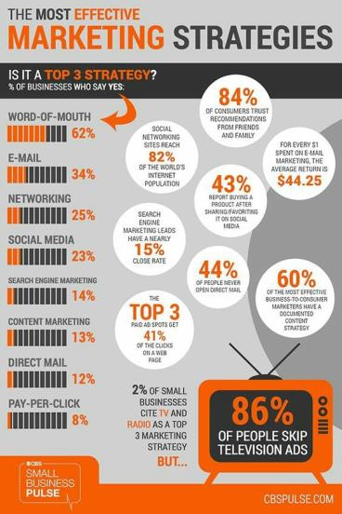
MarketPlaceName
They are Everywhere
2016 Transaction Value IDR 10 trillion
2016 Page-views 16,75x compared to 2015
(13.4 bio vs 800 mio)
TRENDS 2017 DIGITAL MARKETING
Social Media are used for Selling and Advertising
Global Ads Spending in Social Media will Grow 72% between 2016-2019
-Zenith Opti Media-
CHALLENGES 2017 DIGITAL MARKETING
Ads = SPAM
When I want something, I just SEARCH it and Buy it without seeing the Ads first
80% of Buying Decision in Indonesia are Dominated by Brand Exposure in Social Media
-BMI Research-

Slide 9
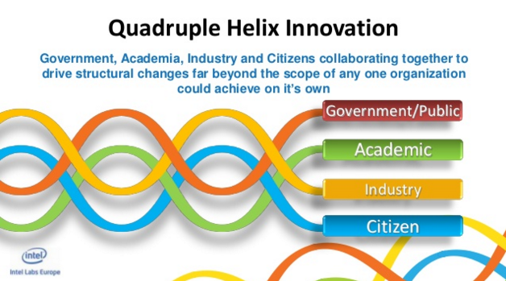

QUADRUPLE HELIX CONCEPT
Government, Academia, Industry and Community collaborating together to drive structural changes far beyond the scope of any one organization could achieve on it’s own
GOVERMENT
ACADEMIC
INDUSTRY
COMMUNITY

Slide 10
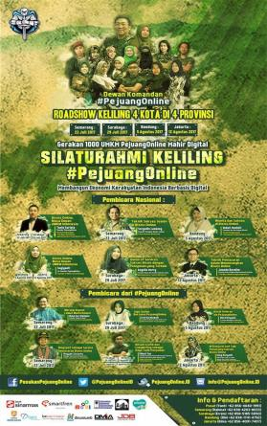
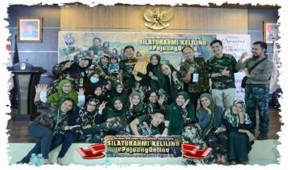
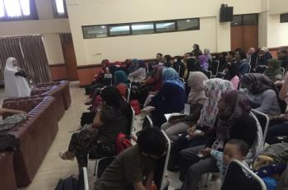
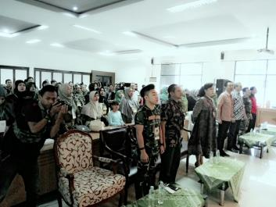
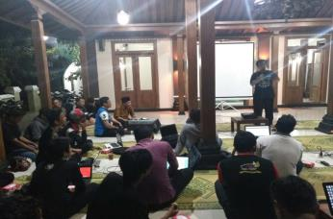
Smartfren Contributions

Slide 11
Smartfren Contributions
Largest 4G LTE Network in Indonesia
http://nperf.com
Affordable 4G Smartphones
Quadruple Helix Collaboration
Accompaniment and Empowerment Online Business Owner

Slide 12
TANTO SURIOTO
Email :
Mobile :
WA :
tanto.surioto@smartfren.com
+62 888 185 0606
+62 818 6 555 67

